Slide 1
eHealth Project
Jack, Josh, Ruxandra & Patrick

Slide 2
Brief
Find out about particular conditions & treatments
Gather information from different medical sites
Save helpful information that they find
Provide a self-diagnosis for site users

Slide 3

Target Users
Brian | Brian is 18 years old and is a university freshman. Brian is a typical student, goes to class and does his assignment during the week, and then goes out with friends during the weekend. Going to university is his first time living on his own, having lived with his parents, with whom he had always been close. Brian decides that he would work on becoming more independent and try to prove to his parents that he is fine living on his own. | He doesn't really remember what could have caused it, but Brian wakes up on a Monday morning feeling quite terrible. He tells himself that it will all be fine and that it will pass by the evening, but by the time he gets home, he feels a lot worse. He thinks he should go to the doctor, but then realises that up until then, it had always been his mother making his appointments for him. He realises he doesn’t even know where the nearest clinic is, that it’s probably too late to call now anyways and thinks that maybe his condition isn’t that bad anyways. He does recall a pharmacy nearby that should still be open, but he doesn’t really know what he should get to feel better at least for the night. So Brian decides to go online and look for his symptoms on eHealth and see what other people have done, and if he doesn’t find anything, he might go to the doctor in the end.

Slide 4
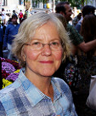
Target Users
Mary | Works part time at a small charity shop, close to her. Is 55 year old, has a basic education. She has experience working in administration in a hospital, in a medium sized group of other people. Currently suffering with arthritis and other miscellaneous ailments. Has a little bit of knowledge regarding medicine since she worked in a hospital. | Has been visiting the GP regularly because of her multiple health problems. Wishes she didn’t have to spend so much time having to organise seeing the GP just for common problems. Would be helpful to have extra information to have an easier time with the GP or to avoid wasting time.

Slide 5
ER Diagram

Slide 6
High Level Architecture

Slide 7
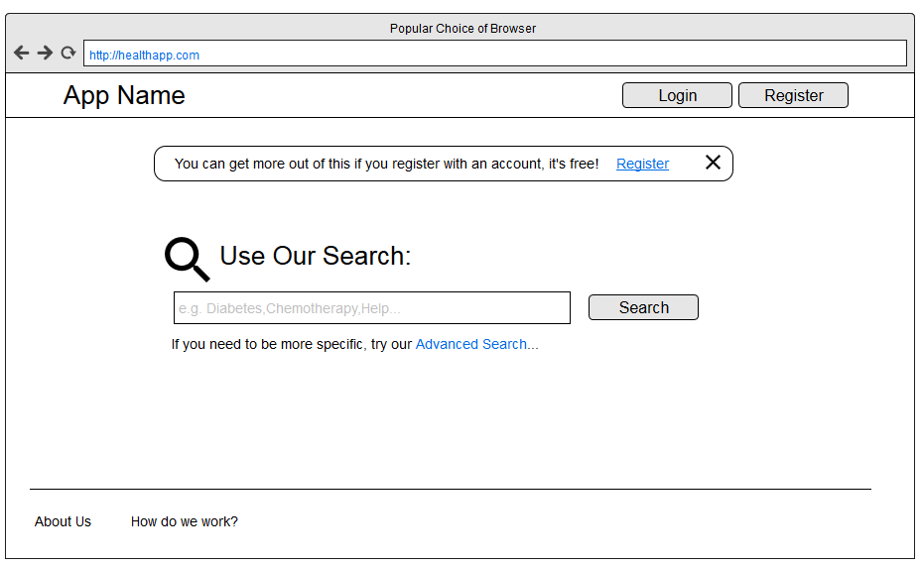
Main View

Slide 8
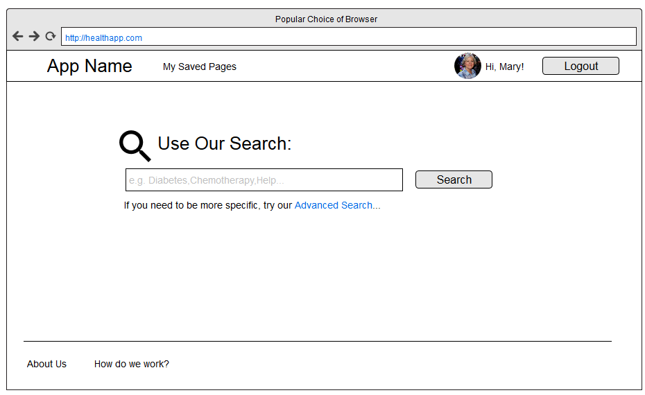
Main View (logged in)

Slide 9
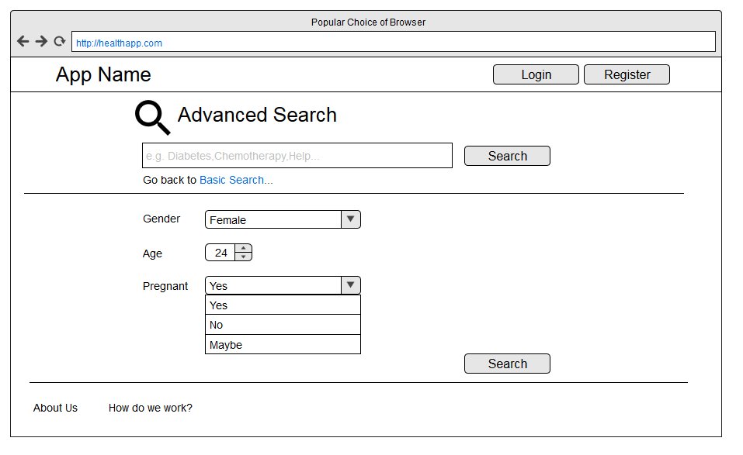
Main View (Advanced Search)

Slide 10
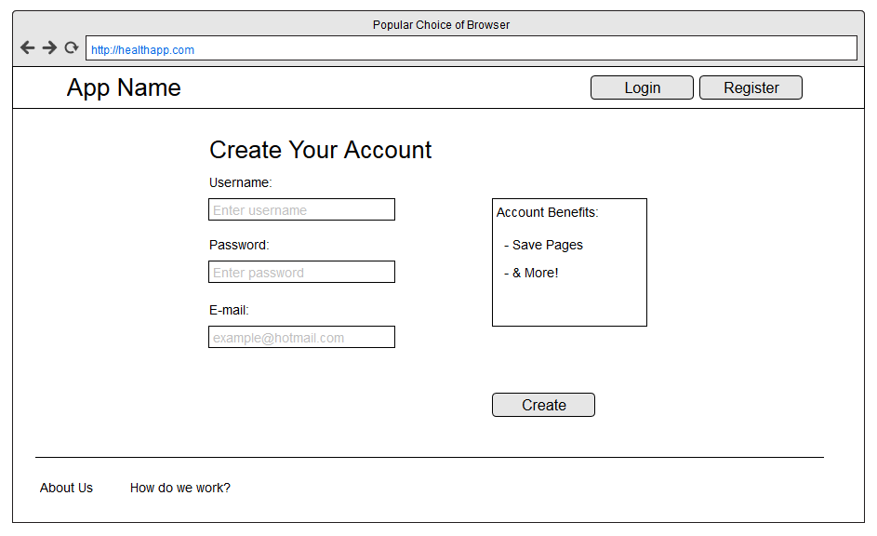
Registration Page (Account)

Slide 11
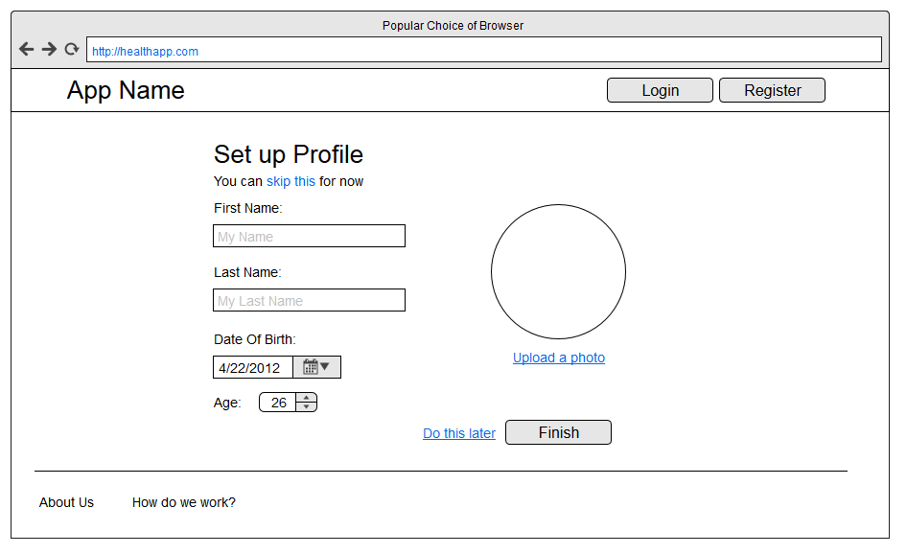
Registration Page (Profile)

Slide 12
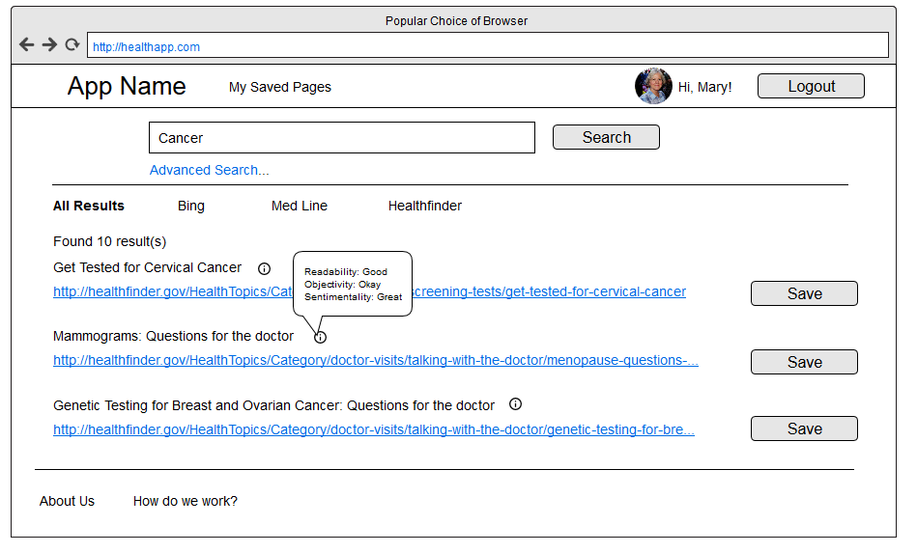
Results view

Slide 13
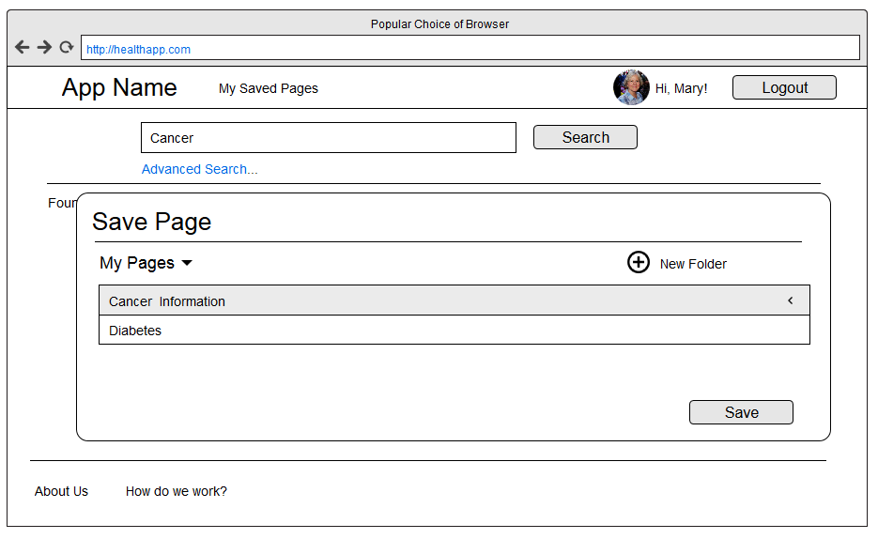
Results view (Save Confirmation)

Slide 14
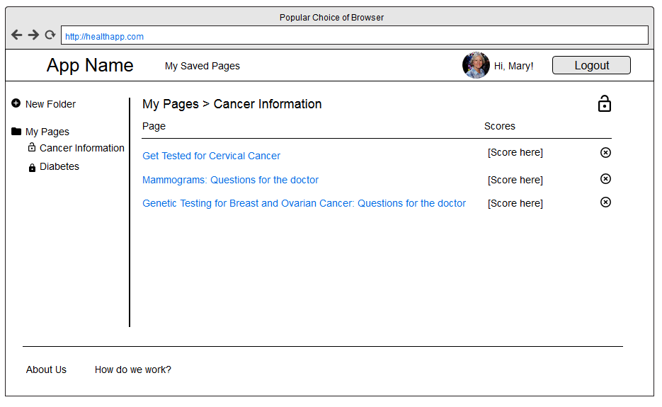
Categories View

